Slide 1














ECMA-Script
2024
Presented by
Balaji B

Slide 2

What is ECMA?
European Computer Manufacturers Association - ECMA
ECMAScript is a standard for scripting languages, including JavaScript, JScript, and ActionScript. It is best known as a JavaScript standard intended to ensure the interoperability of web pages across different web browsers.

Slide 3
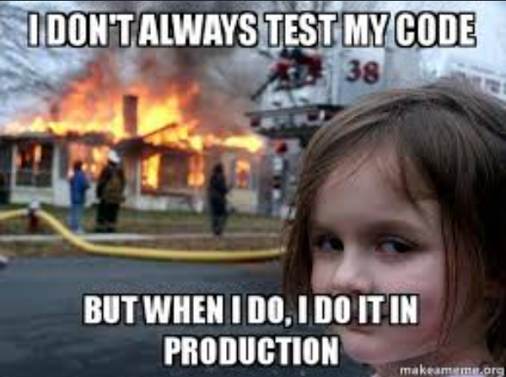

Slide 4
Topics
01
02
03
04
Tuples
&
Records
Array New Copy methods
Object
“Groupby”
Method
Set
New methods

Slide 5
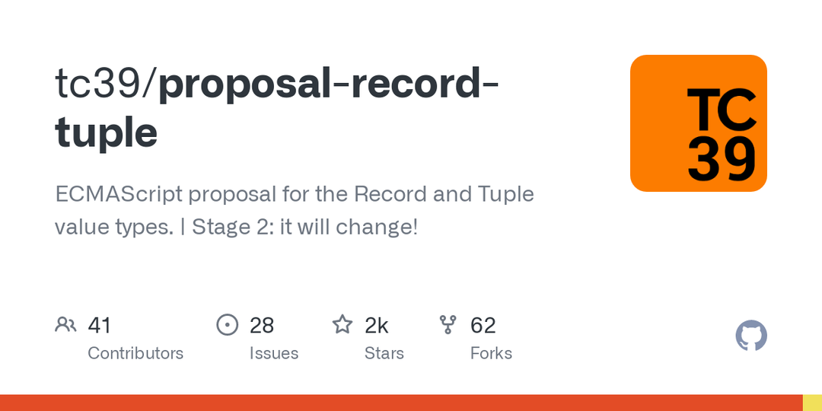
01.
It is a new primitive data type in the JavaScript
Tuples & Records
Since its primitive we can’t use the non - primitive values in this structure.
02.
Still on stage 2 development so we can see enhancements later
03.

Slide 6

Object GroupBy
The Object.groupBy() static method groups the elements of a given iterable according to the string values returned by a provided callback function.
The returned object has separate properties for each group, containing arrays with the elements in the group.

Slide 7

01.
array.toSorted();
Array New method
02.
array.toReverse();
03.
array.toReverse();
03.
array.with();

Slide 8
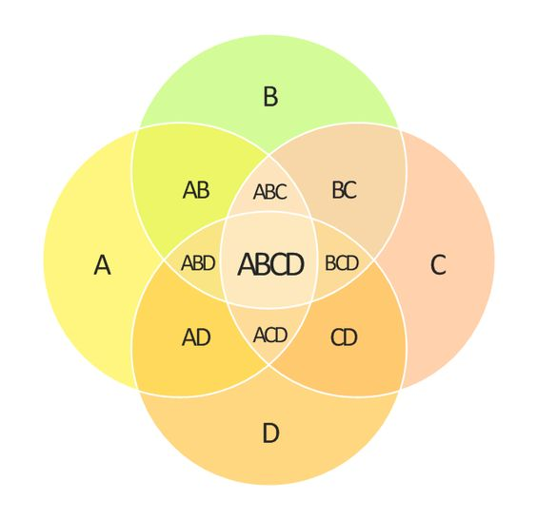

Slide 9
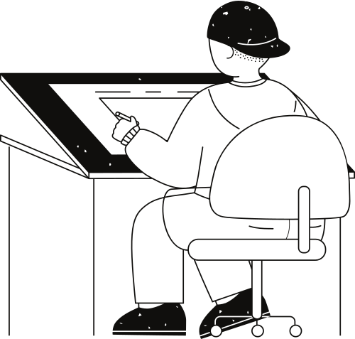






Difference
Union
Set
intersection
isDisjointFrom
A value in the set may only occur once
Symmetric
Difference
IsSubsetOf
IsSupersetOf

Slide 10
Few other developments are on they way
01
02
03
04
Temporals
Promises withResolver
String.Prototype
and so on.....

Slide 11
Thank you very much!

